Slide 1

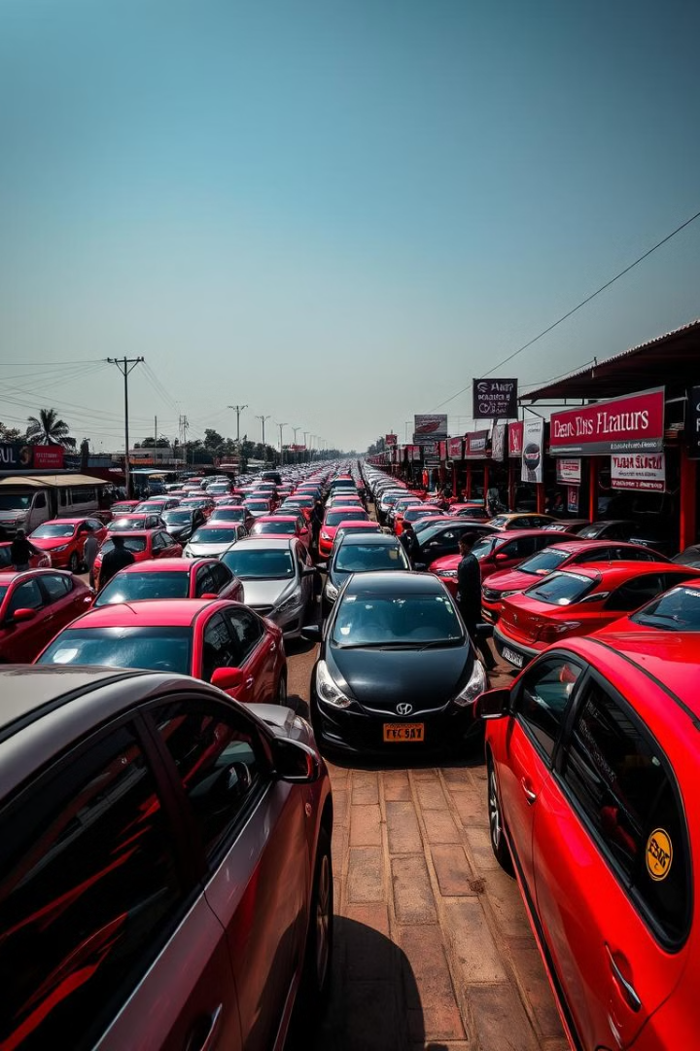

Analysis of Used Car Market Trends in India
This report presents an in-depth analysis of the used car market in India, examining key trends, pricing dynamics, and regional variations. The findings are based on structured data processing, cleaning, and visualization using tools like MySQL and Tableau. This analysis aims to provide valuable insights for dealers, buyers, and manufacturers.
by Harshit Jain
Notes:
1

Slide 2
Data Cleaning and Preprocessing
Price Column Fix
Transmission Data Corrected
Engine Capacity Fixed
Replaced 'Call' entries with NULL values and converted the price column to INT to ensure accurate price analysis and remove inconsistencies.
Entries like 'cc' were corrected based on other similar models, providing a standardized engine capacity for performance analysis.
Fixed incorrect entries (e.g., 'R' and '4') by referencing similar models, ensuring reliable transmission type data for market segmentation.
Notes:
2

Slide 3
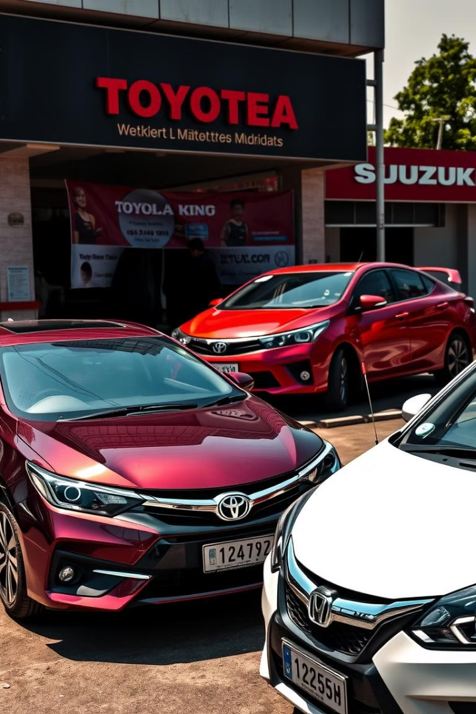


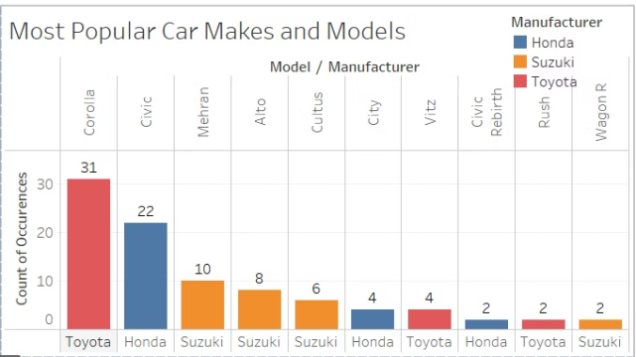
Most Popular Car Manufacturers & Models
Top Manufacturers
Business Insight
Toyota, Honda, and Suzuki lead in the used car market. Toyota Corolla stands out as the most popular model, with 31 occurrences, followed by Honda Civic and Suzuki Mehran.
Dealers should prioritize stocking Toyota Corolla and Honda Civic due to their high demand, ensuring a quicker turnover and higher sales volume.
Notes:
3

Slide 4


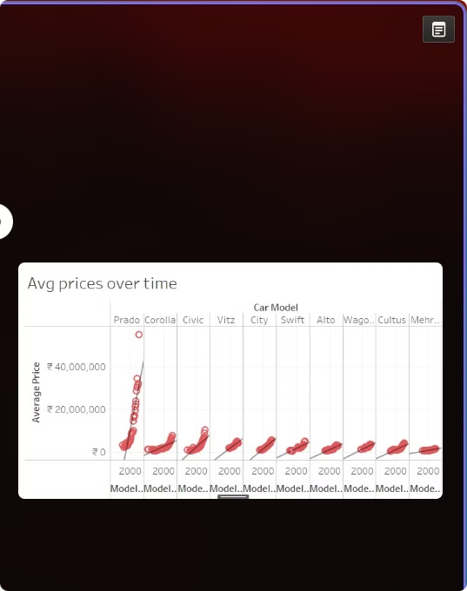



Price Trends Over Time
Price Fluctuation
Average car prices fluctuate over the years but have remained relatively stable for commonly traded models, reflecting market demand and depreciation factors.
High-End Models
High-end models like Toyota Prado show significantly higher average prices due to their premium features and perceived value in the used car market.
Budget-Friendly Options
Buyers looking for budget-friendly options should consider models from previous years where depreciation is more evident, offering cost-effective alternatives.
Notes:
4

Slide 5
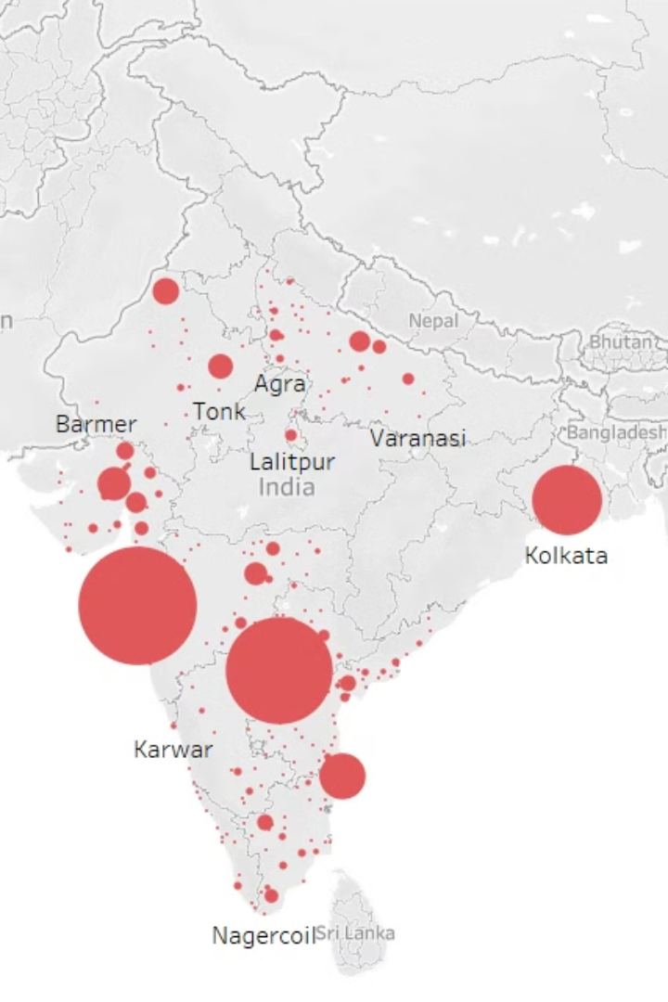
Car Availability by Location
Metropolitan Cities
Smaller Towns
Major metropolitan cities like Mumbai, Delhi, and Kolkata have the highest availability of used cars, reflecting higher population density and market activity.
Smaller towns show limited inventory, making them potential growth markets for used car dealerships to expand their reach and cater to untapped demand.
Business Expansion
Dealers should consider expanding operations in Tier-2 cities where availability is lower but demand could be high, capitalizing on emerging markets.
Notes:
5

Slide 6
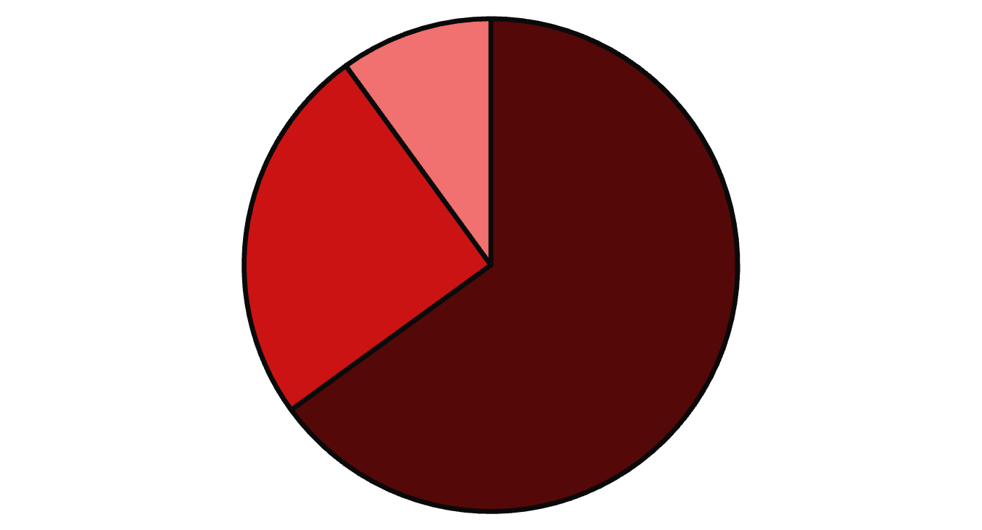
Fuel Type Distribution
Petrol
Diesel
Hybrid
Petrol cars dominate the used car market, reflecting historical preferences and availability. Diesel and hybrid cars are available in fewer numbers but command higher average prices due to fuel efficiency and eco-friendliness.
Notes:
6

Slide 7
Transmission Type Trends
Manual Transmissions
Automatic Cars
Premium Offering
Manual transmissions dominate the market, appealing to a broad base of consumers seeking affordability and control over driving experience.
Automatic cars, though fewer in number, tend to be priced higher on average, targeting urban buyers seeking convenience in congested traffic conditions.
Dealers should promote automatic cars as a premium offering, highlighting the comfort and ease of use to attract urban buyers.
Notes:
7

Slide 8
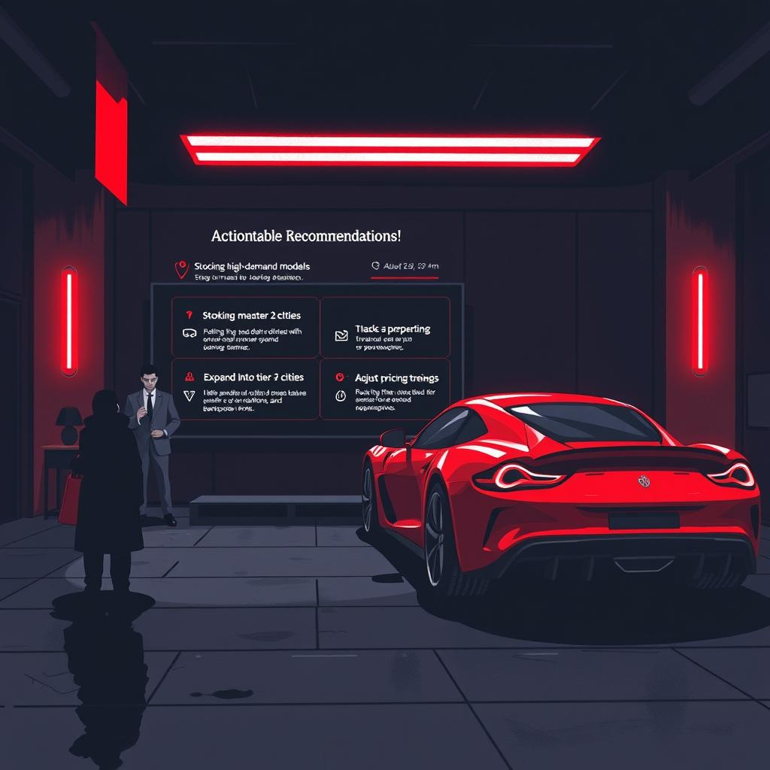
Actionable Recommendations
1
Stock High-Demand Models
2
Expand in Tier-2 Cities
Dealerships should stock high-demand models like Toyota Corolla and Honda Civic to ensure quicker sales and higher revenue.
Focus on expanding in Tier-2 cities where inventory is lower but demand is potentially high, tapping into new market opportunities.
3
Pricing Adjustments
Consider pricing adjustments based on historical depreciation trends to offer competitive prices and attract value-conscious buyers.
Notes:
8

Slide 9
THANK YOU!
Notes:
8

